Slide 1
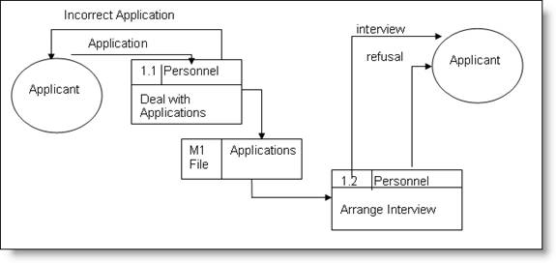
Activity 6: FlashIT - DFD Level 1

